Slide 1
Weekly Presentation
Jiayu Chen
2023.8.21
Notes:
Ok, I will begin my weekly Presentation

Slide 2
Work Description
Work_1: Attempting to predict S and D using signals with a noise level of 0.8 by decomposition. The achieved MAE for S is 3.9, and for D is 5.8, compared to last week's values of S=13 and D=9.
Work_2: Attempting to predict S and D using signals with a noise level of 0.1 by getting template. Some interesting observations were made.
Work_3:Tutorial Writing
Work_4:Theoretical knowledge Learning

Slide 3
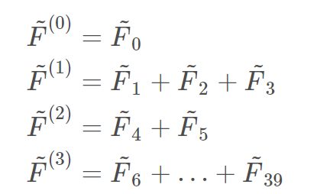
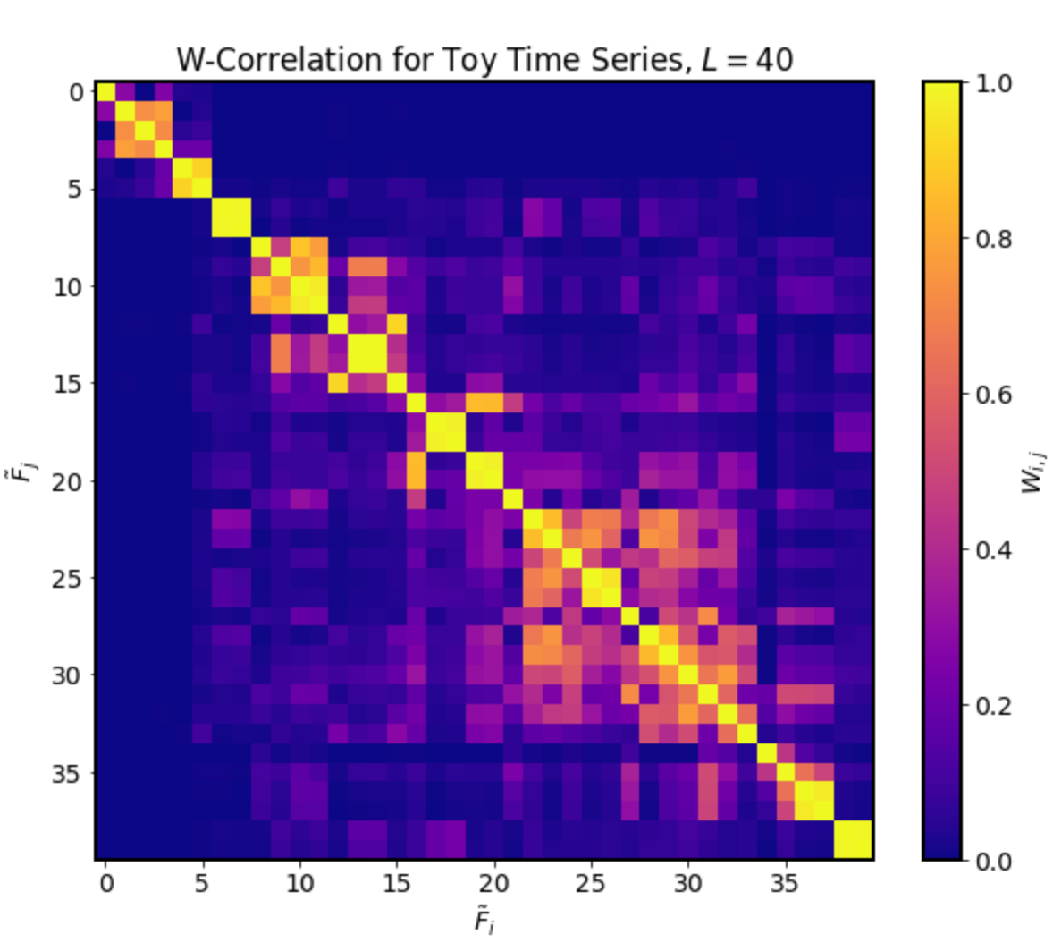
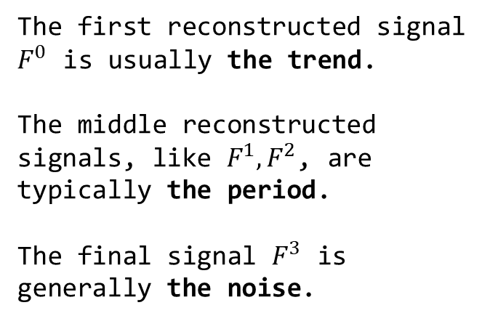
Work_1: S & D prediction in the noise level of 0.8
Process of Singular
Spectrum Analysis (SSA)
Step2.
Time Series Component Separation and Grouping
Components of time series are grouped together through visual inspection.
Step1.
perform SVD on the processed signal, and compute the W-correlation coefficients
Step3.
Reconstruct signals based on the groups
The first reconstructed signal $F^{0}$ is usually the trend.
The middle reconstructed signals, like $F^{1}, F^{2}$, are typically the period.
The final signal $F^{3}$ is generally the noise.
Notes:
In this week's tutorial writing, I found that Singular Spectrum Analysis (SSA) works exceptionally well for denoising SCG signals in high-noise situations.
Let's take a look at Process of Singular Spectrum Analysis .
Step one is performing Singular Value Decomposition (SVD) on the processed signal, and computing the W-correlation coefficients.
In step two, Time Series Component Separation and Grouping, the components of the time series are grouped together through visual inspection. Which means， I just look at the picture of W-correlation and divide it into several groups together manually. In this matrix, we identified four such blocks, corresponding to the four green boxes.
Currently, it seems there isn't an automated method for the grouping.
Step three involves reconstructing signals based on these groups.
On the left are signal components within the four green boxes, reconstructed into four signals.
The first reconstructed signal, 𝐹^0, usually represents the trend.
The middle reconstructed signals, like 𝐹^1, 𝐹^2, typically represent periodic components.
The final signal, 𝐹^3, generally represents noise.

Slide 4
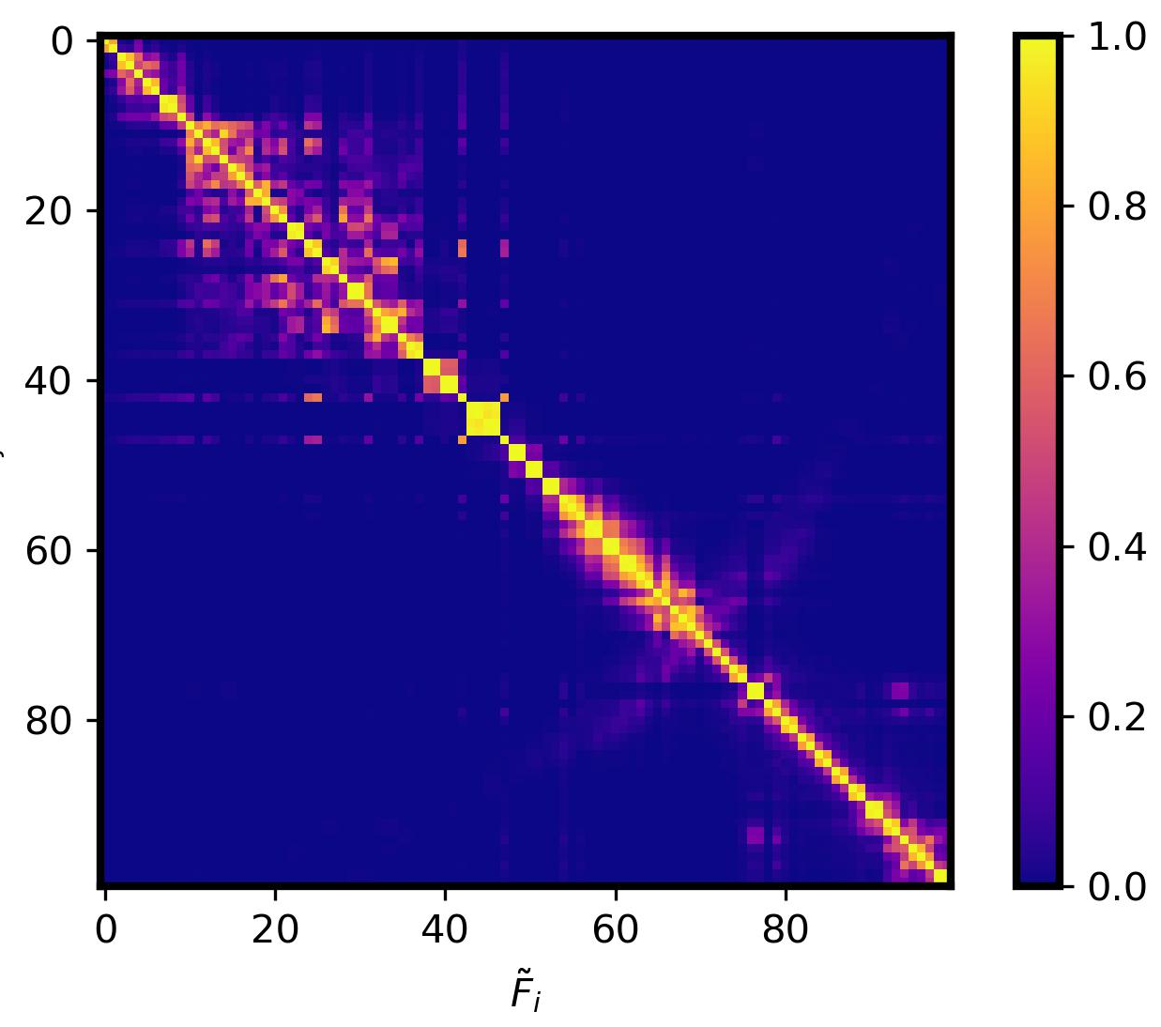
Work_1: S & D prediction in the noise level of 0.8
The process of simplified SSA I used
Step2.
Based on empirical values, components of time series are divided in two groups: Trend + (Period + Noise).
Step3.
Reconstruct signals based on the groups
Step1.
perform SVD on the processed signal, and compute the W-correlation coefficients
The first reconstructed signal is generally the trend.
The second reconstructed signal is a combination of the period and the noise.
Notes:
In practical scenarios, dealing with thousands of SCG signals makes it impossible to apply Step 2 of SSA, which involves visual inspection and subjective grouping. Thus, practical application becomes challenging.
In Step 2, I've made a change. Instead of dividing it into Trend + Period + Noise, I've divided it into two main groups: Trend + (Period + Noise). The points of division between these two components are determined based on empirical values.

Slide 5
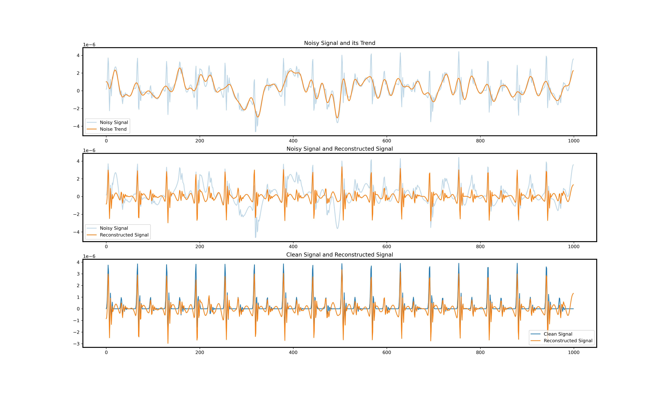
Work_1: S & D prediction in the noise level of 0.8
The effectiveness of denoising using SSA
Original SCG signal with a noise level of 0.8
Trend extracted using SSA
Original SCG signal with a noise level of 0.8
(Period + Noise) extracted using SSA
SCG signal with no noise
(Period + Noise) extracted using SSA
Notes:
This image is from my tutorial. In this image, the noise level in the SCG signal is 0.8.
In the first image, the blue line represents the original SCG signal with a noise level of 0.8. The yellow line represents the Trend component extracted using SSA.
In the second image, the yellow line represents the Period+Noise component extracted using SSA.
In the third image, the blue line represents a signal with no noise, while the yellow line represents the Period+Noise component extracted using SSA.
After applying SSA, the distinct peak features that were difficult to discern in the original signal with a noise level of 0.8 are accurately restored.

Slide 6
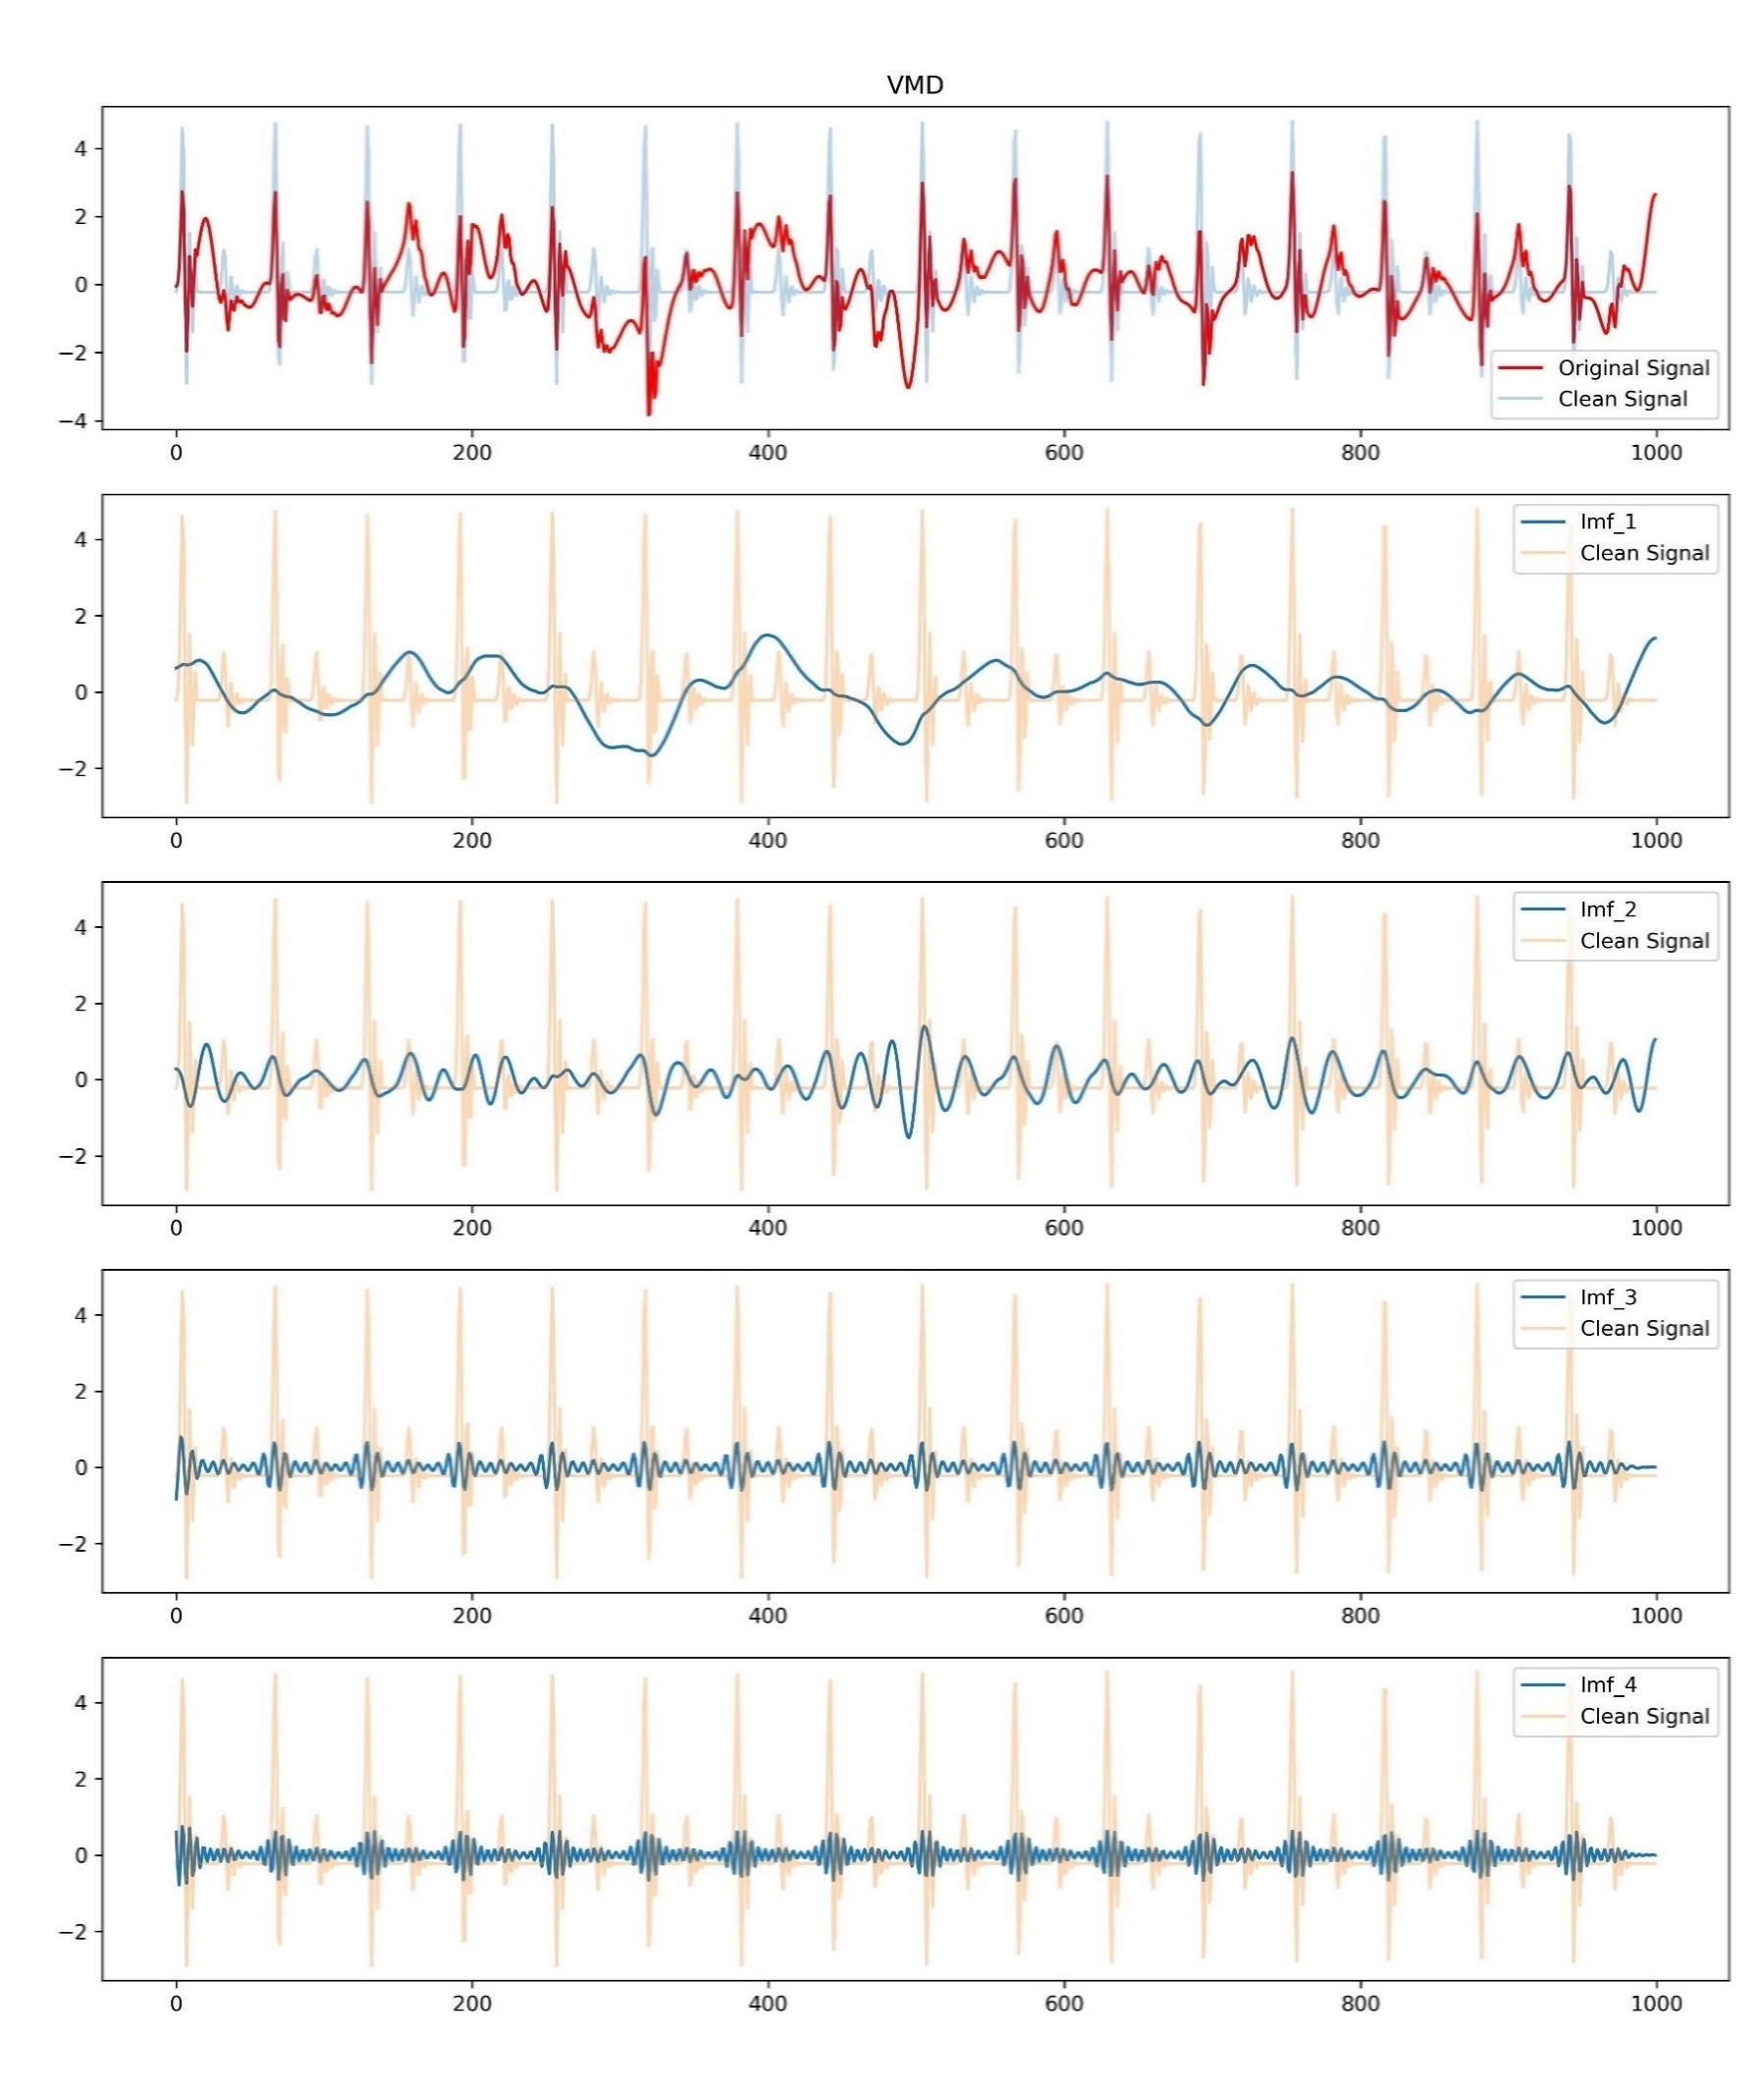
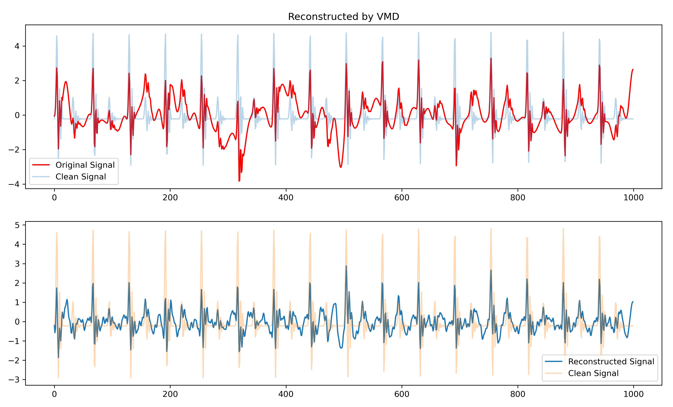
Work_1: S & D prediction in the noise level of 0.8
The decomposition effects of VMD
Reconstruction
The result wasn't very satisfactory. Many peaks still couldn't be identified.
Notes:
Professor Song, I've individually tried out the four decomposition algorithms you mentioned in the Tutorial Outline.
I've performed decomposition on each of them and then reconstructed the signals. The denoising effects are depicted in the figure.

Slide 7
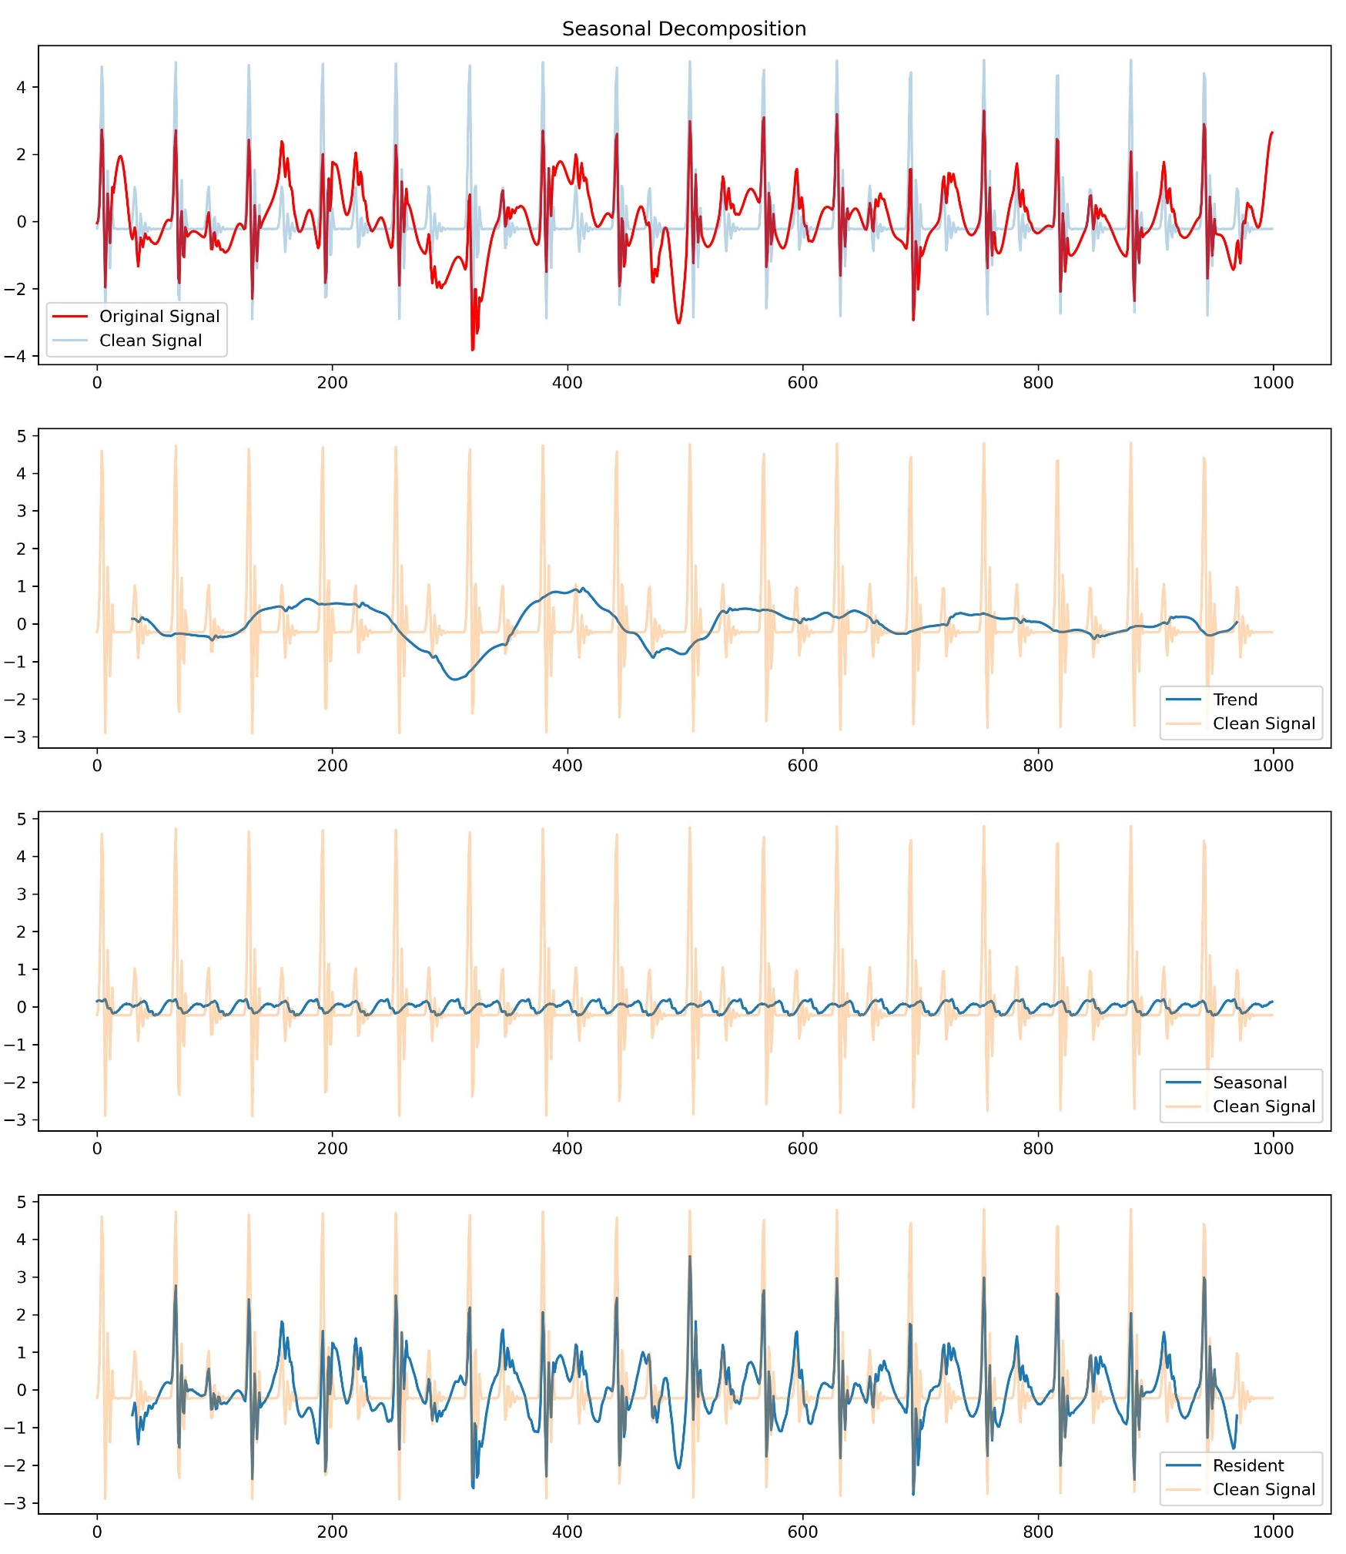
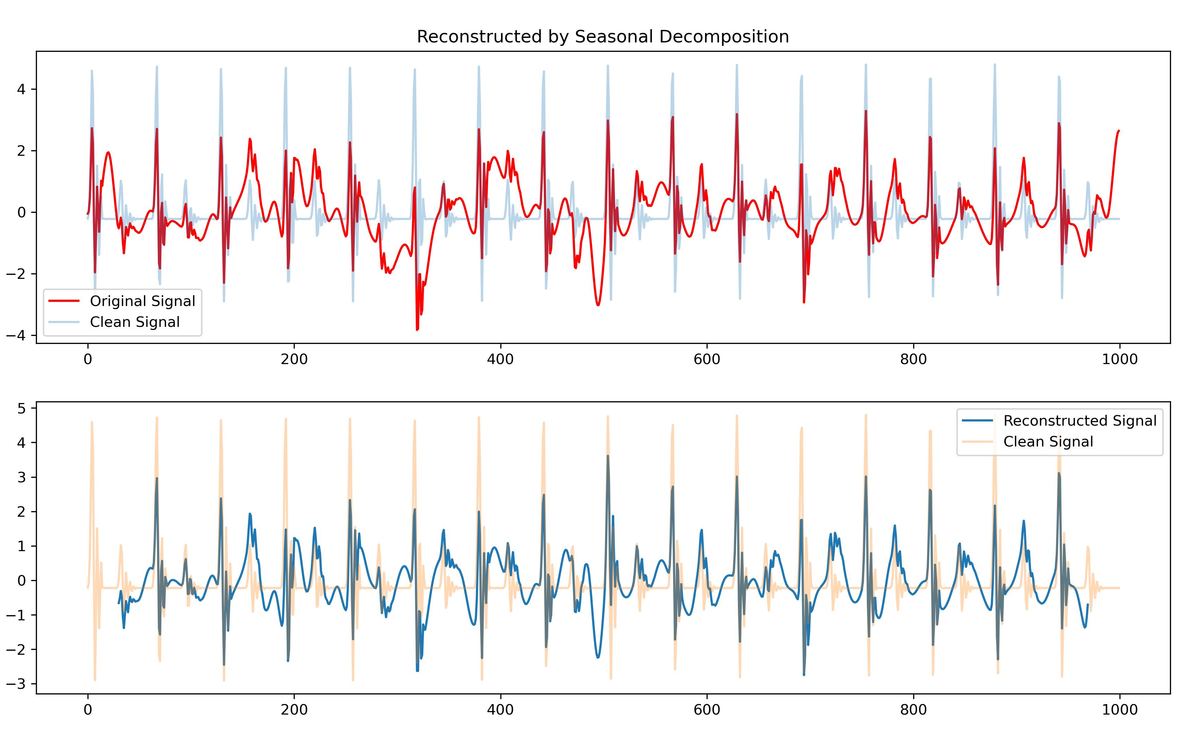
Work_1: S & D prediction in the noise level of 0.8
The decomposition effects of Seasonal Decomposition
Reconstruction
The result wasn't very satisfactory. Many peaks still couldn't be identified.

Slide 8
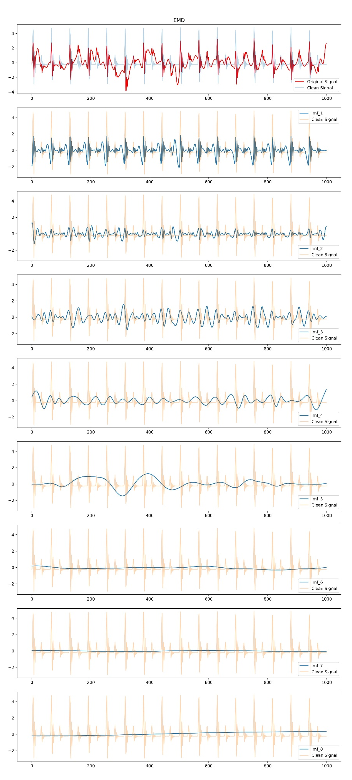
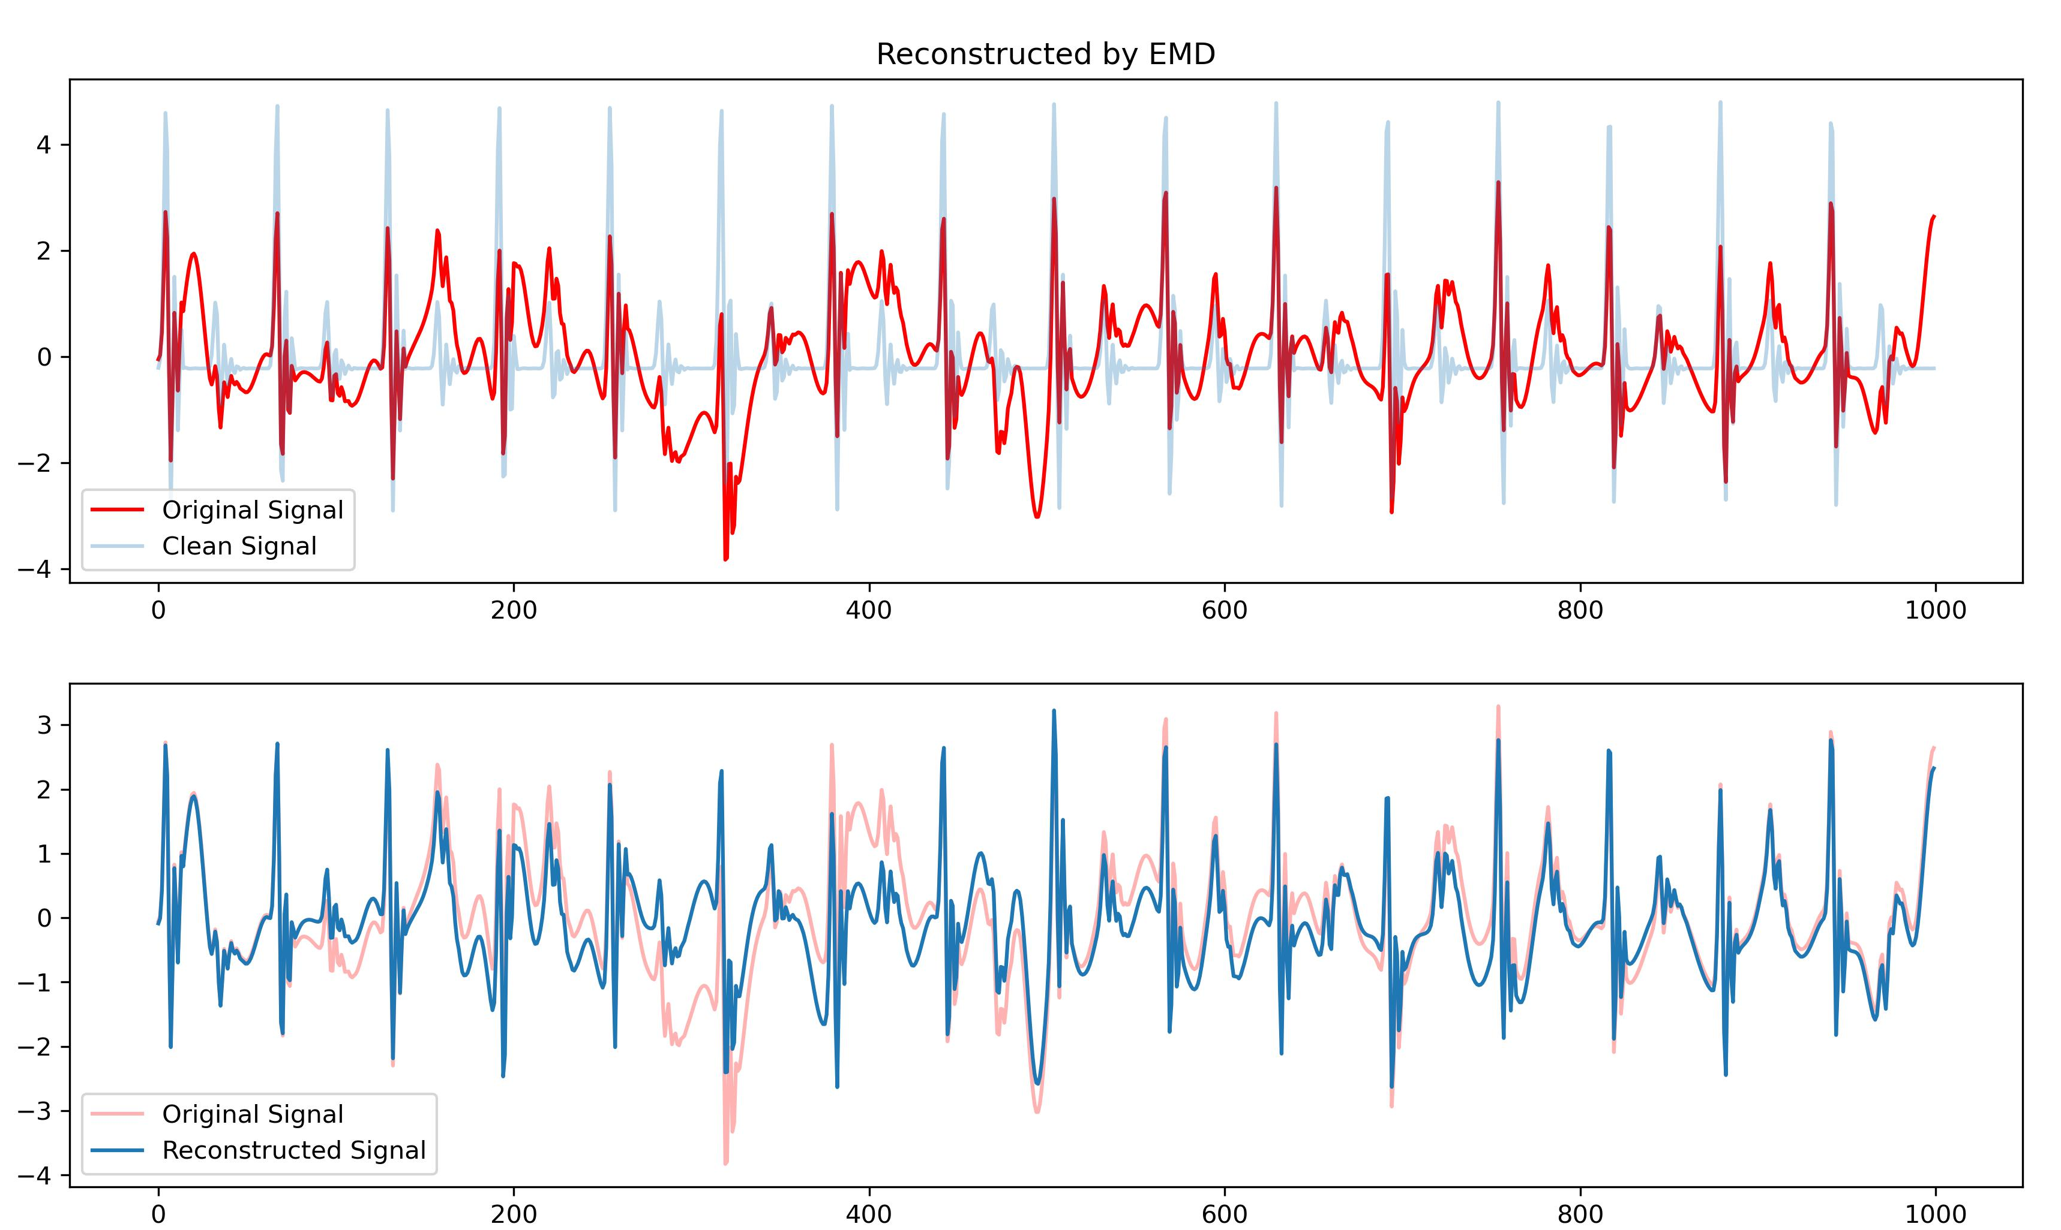
Work_1: S & D prediction in the noise level of 0.8
The decomposition effects of EMD
Reconstruction
Trend
The noise reduction effect is not ideal.

Slide 9
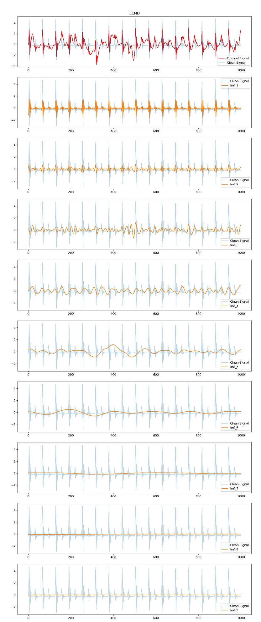
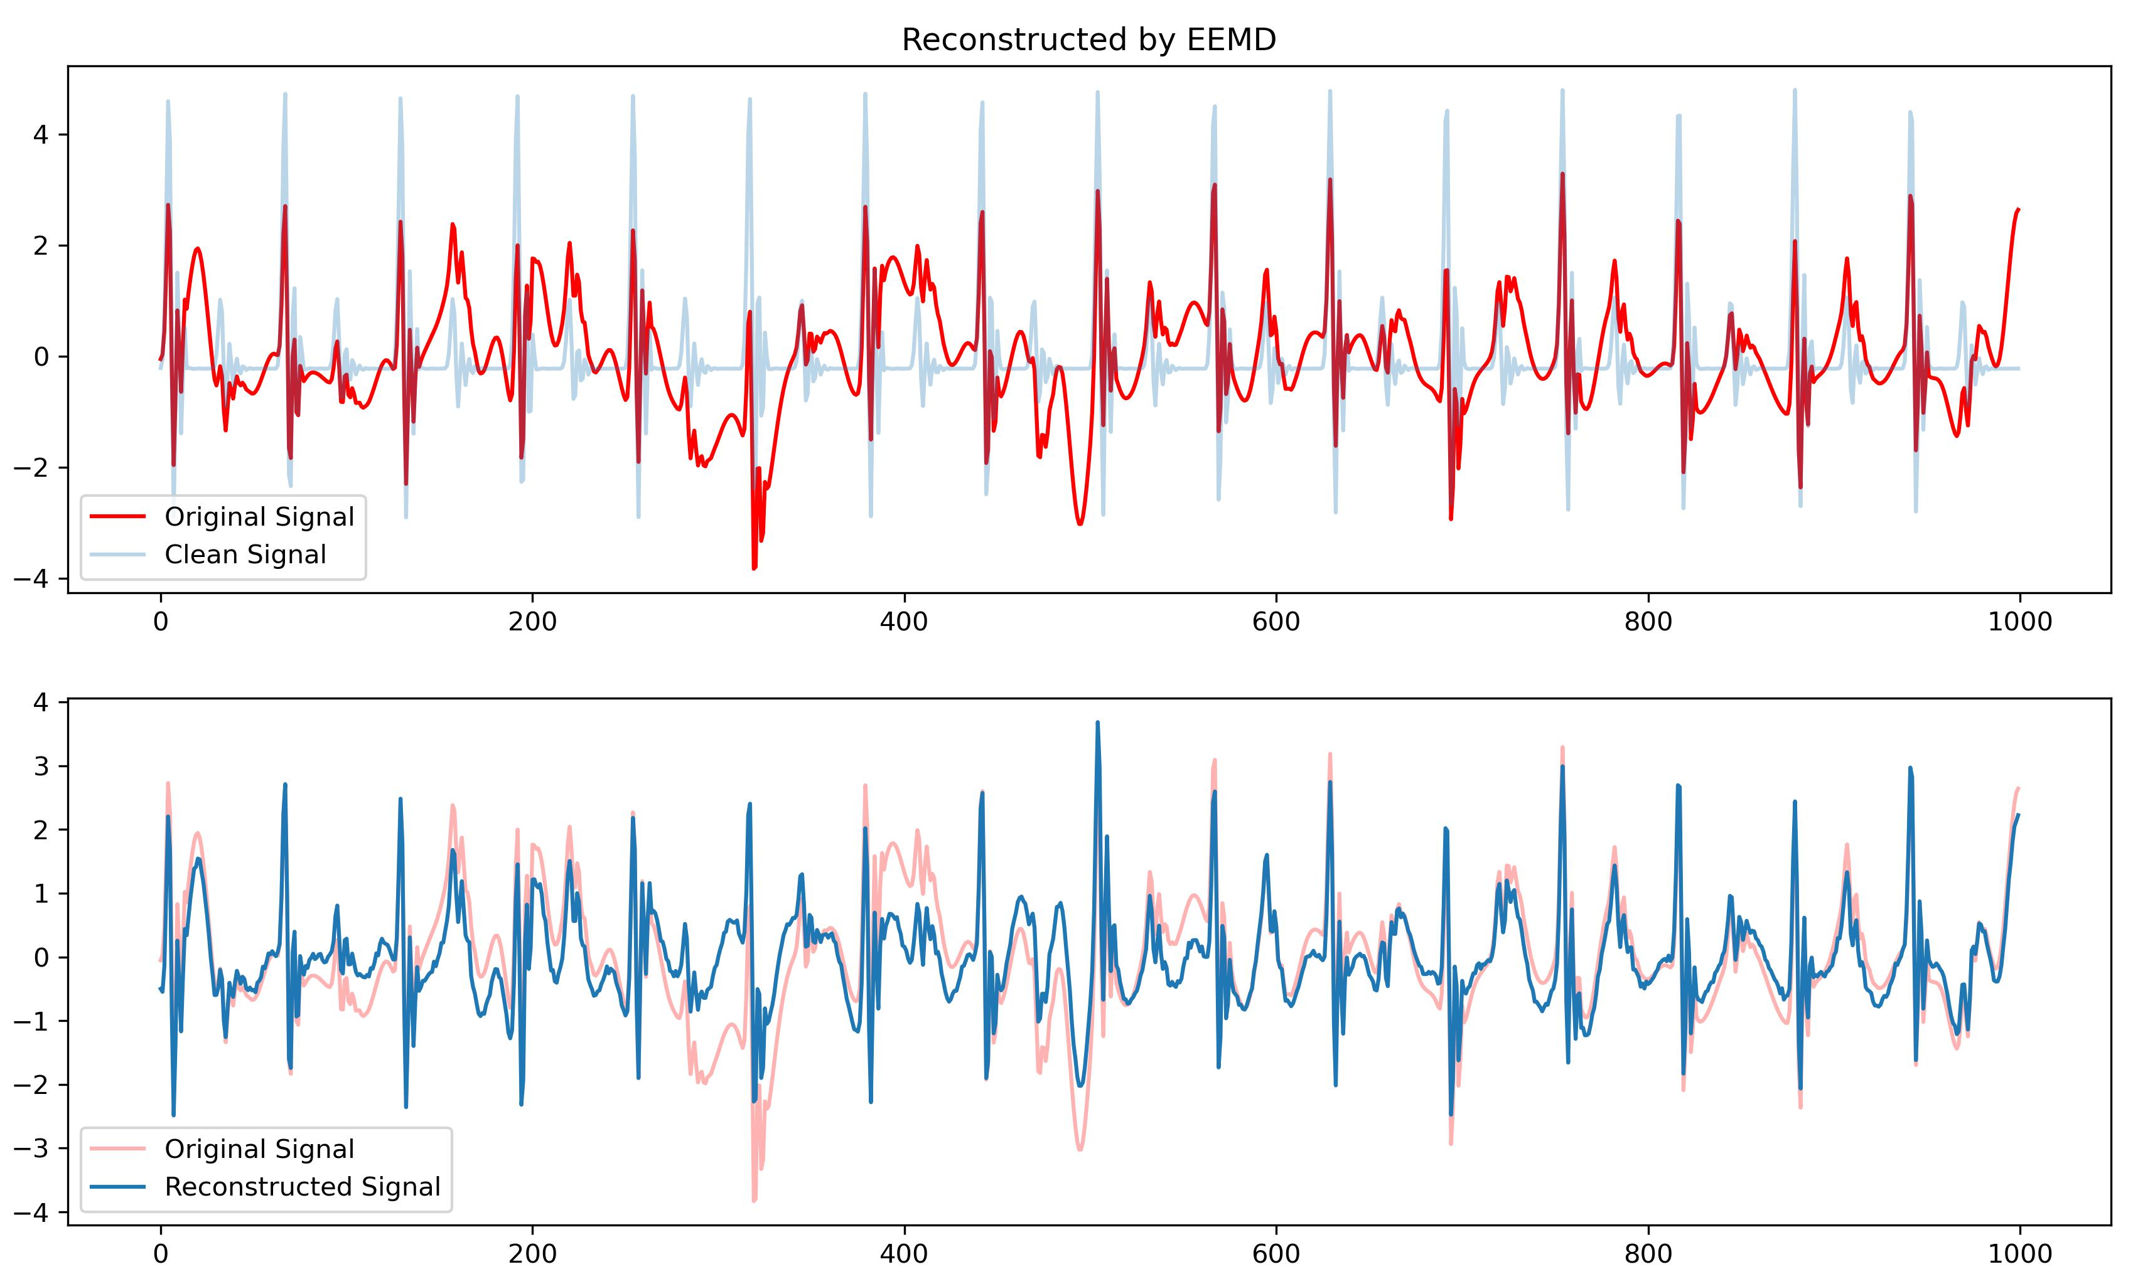
Work_1: S & D prediction in the noise level of 0.8
The decomposition effects of EEMD
Reconstruction
Trend
Noise reduction is better than EMD, but the effect is still poor.

Slide 10
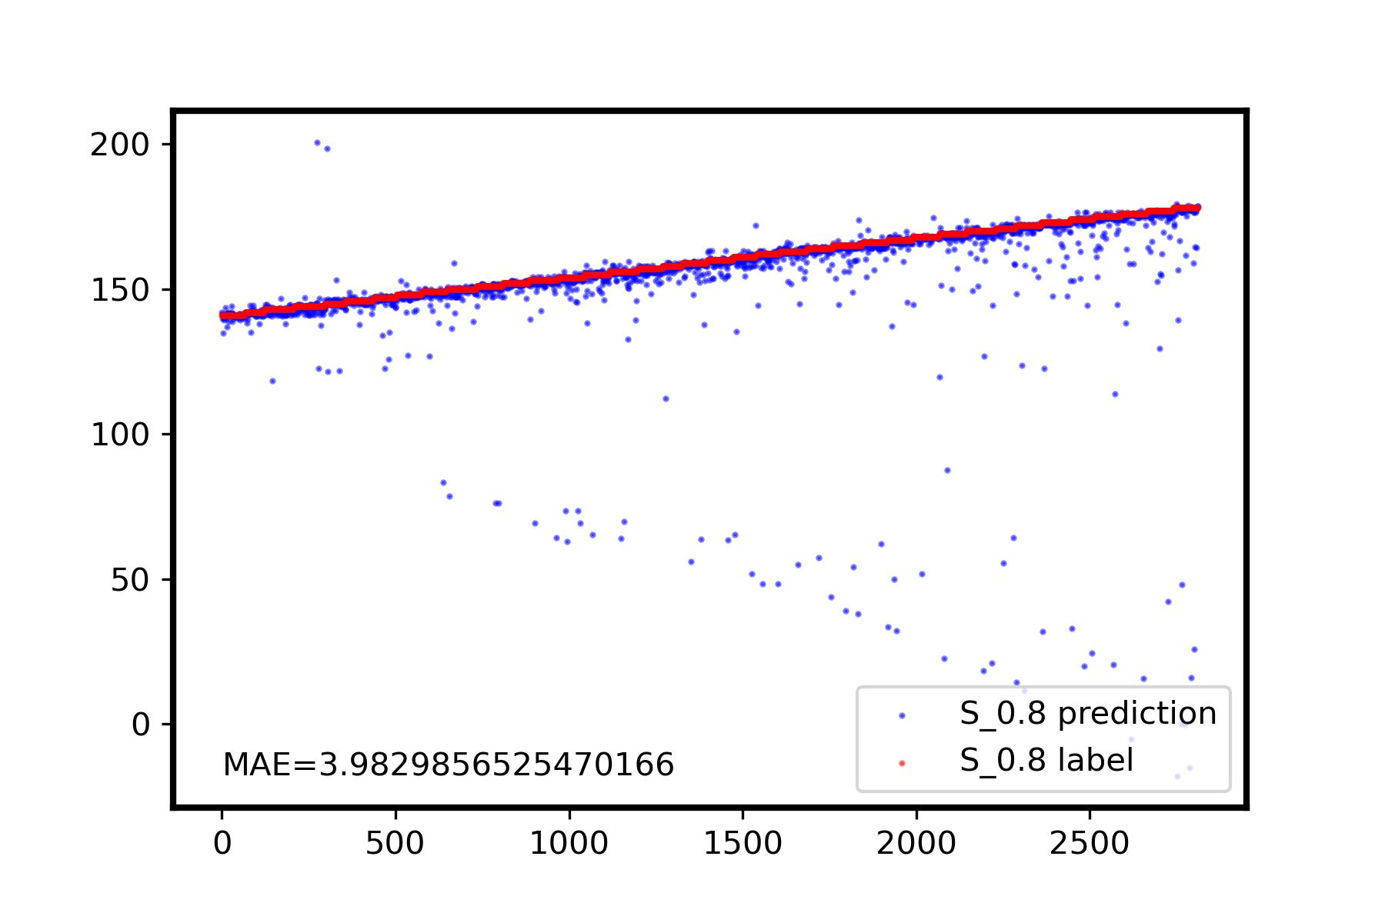
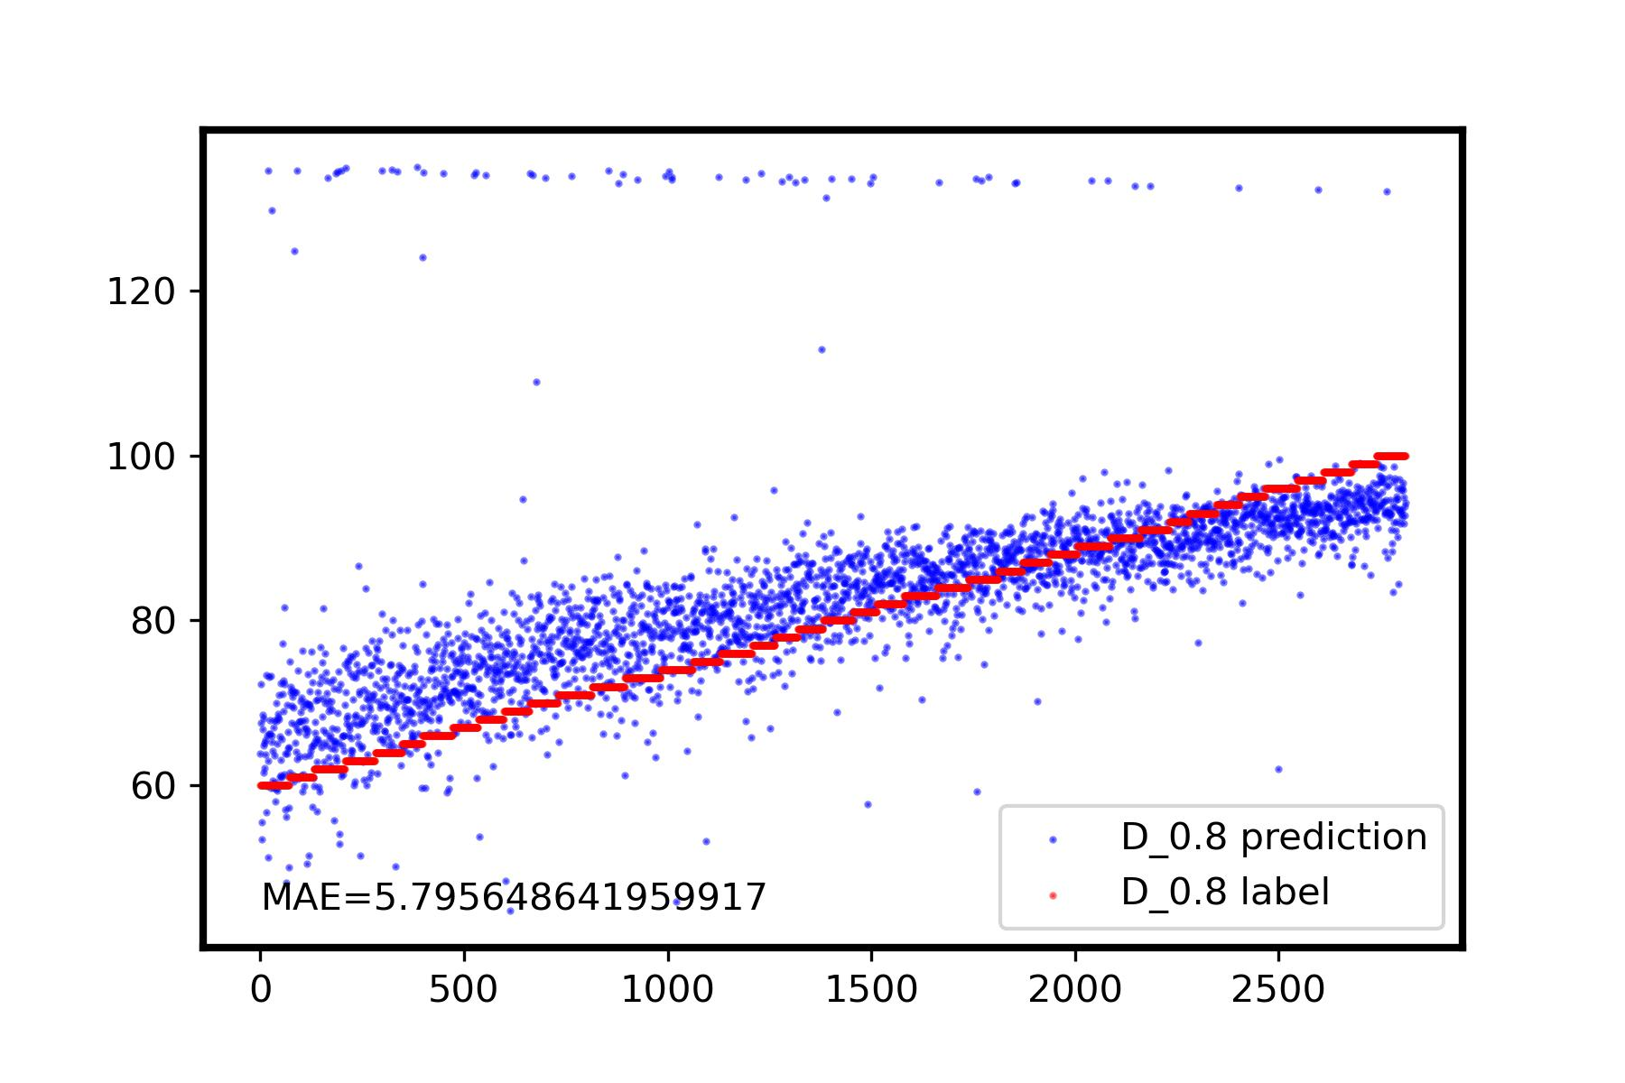
Work_1: S & D prediction in the noise level of 0.8
Prediction Results by using SSA
I believe this method has the potential to achieve MAE < 3 for the prediction of S and D, in the noise level of 0.8. Further optimization lies in achieving higher precision in grouping, rather than through visual inspection.
Surprisingly,
the high predictive accuracy for D using this method is intriguing (last week I used IMF_1 of EEMD, it was completely unpredictable for D), as it suggests that the relative amplitude differences can be effectively restored.
I plan to delve into the mathematical principles to gain a clearer understanding next week.

Slide 11
Work_2: S & D prediction in the noise level of 0.1 by getting template
Data
(Noise: 0.1, No RR)
Data
(Noise: 0.1, No RR)
Calculate period based on HR
Calculate Period based on peaks detection
Period_distance =
(10s * sampling_rate) / (Peaks_num / 2)
Segmentation
Segmentation
K-shapes Clustering
K-shapes Clustering
Get Template
Get Template
…
…
Notes:
In the second project, I continued to experiment with using templates for prediction at a noise level of 0.1.
We aimed to use the HR value for cycle division. However, we found that employing this segmentation approach introduced some issues. In practice, I used a method that calculates cycles based on peak detection. The calculation formula is shown on the right.

Slide 12
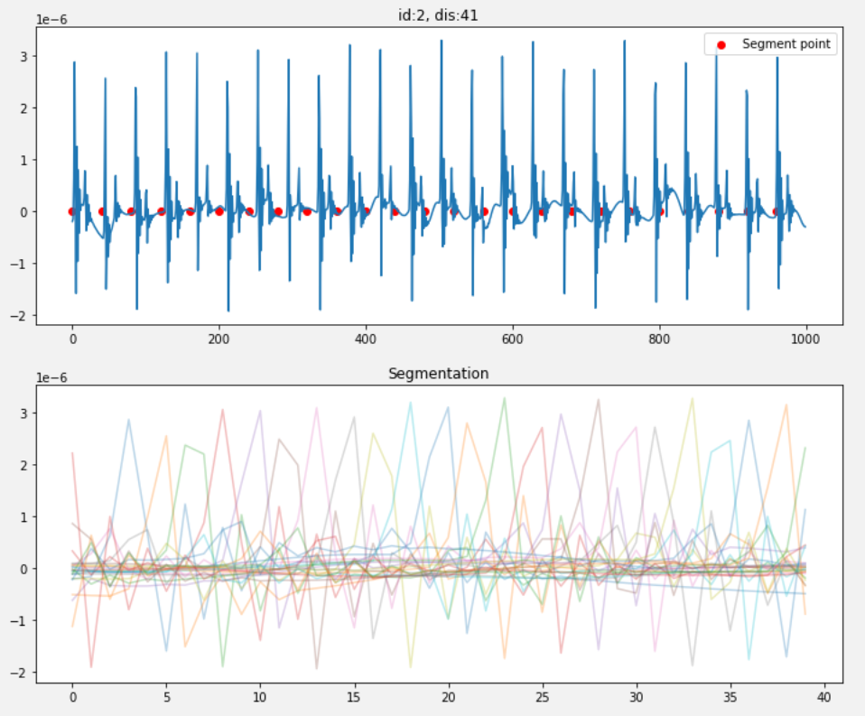
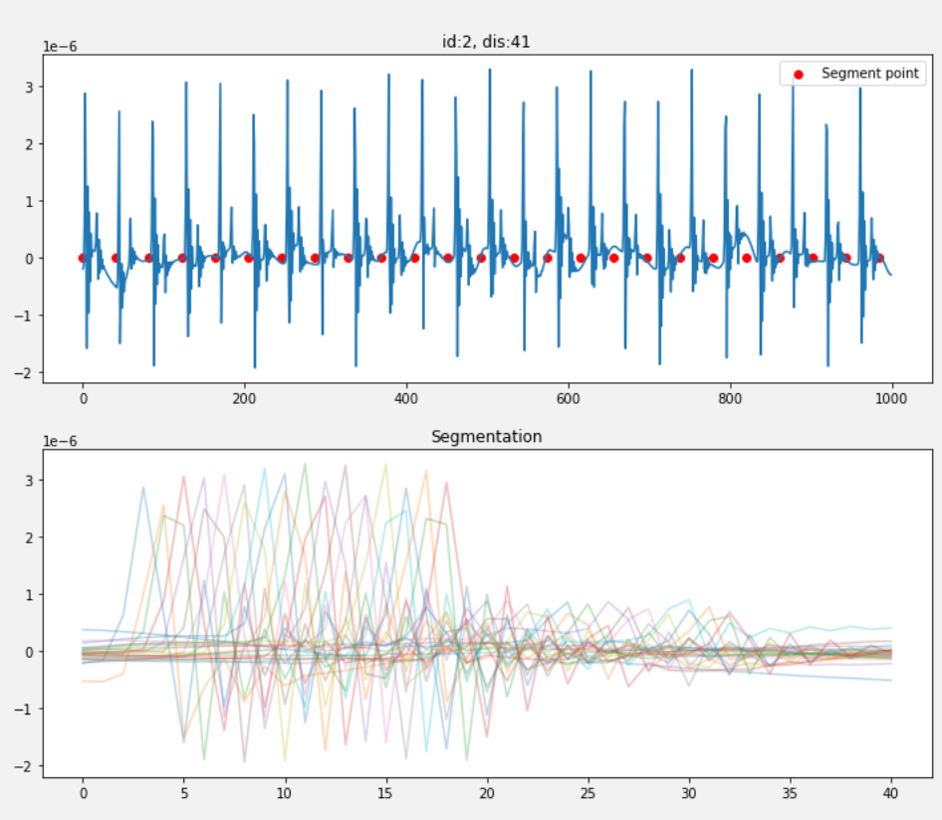
Work_2: S & D prediction in the noise level of 0.1 by getting template
Using HR-based segmentation results, each segment has different shift phases.
The HR per minute is not equal to the HR for these ten seconds. Even a slight error can result in a poor performance.
Segmentation based on peak count yields much better results compared to HR-based segmentation.
Notes:
使用HR进行分隔，会出现很严重的参差现象。
原因在于一分钟的HR数值，与十秒钟内的实际心跳数并不完全相等。一点点的误差周期，就会导致效果很差
此时，kshapes clustering也出现了较大的问题，选中了cluster_1, 它的小峰在大峰左边了。

Slide 13
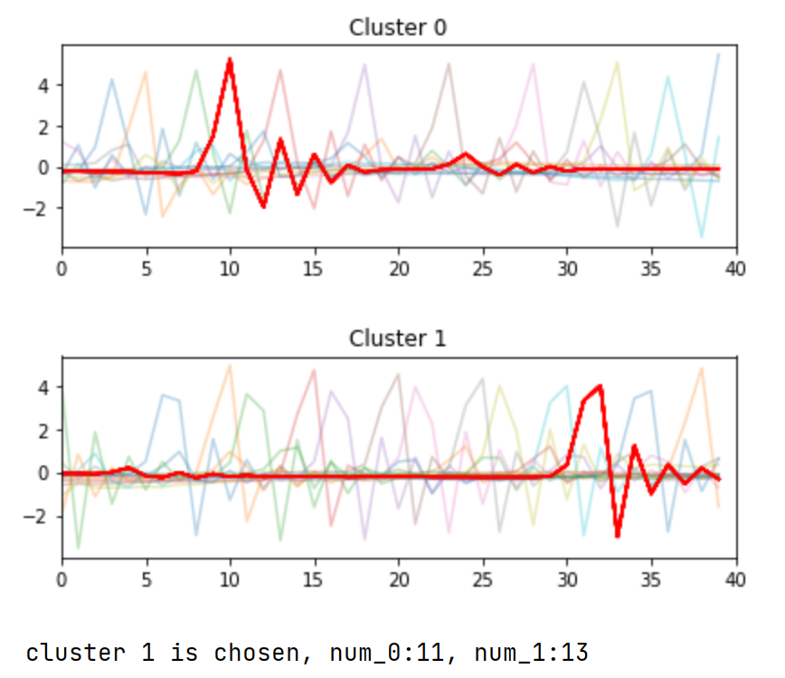
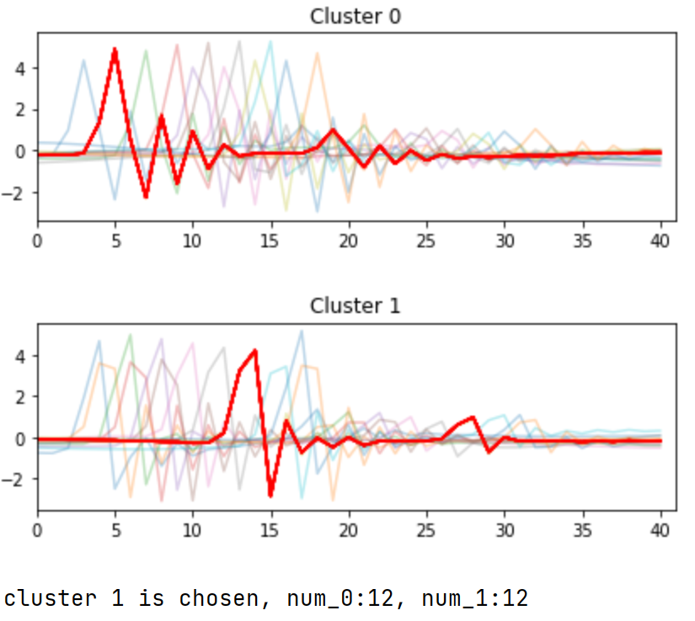
Work_2: S & D prediction in the noise level of 0.1 by getting template
Clustering results using HR-based segmentation results
Result is not satisfactory.
Clustering results using segmentation results based on peak count
Notes:
针对与同一信号，
基于峰数量的周期分隔，效果比基于HR的好很多。它的参差已经好了很多很多了，但是依然不够令人满意。

Slide 14
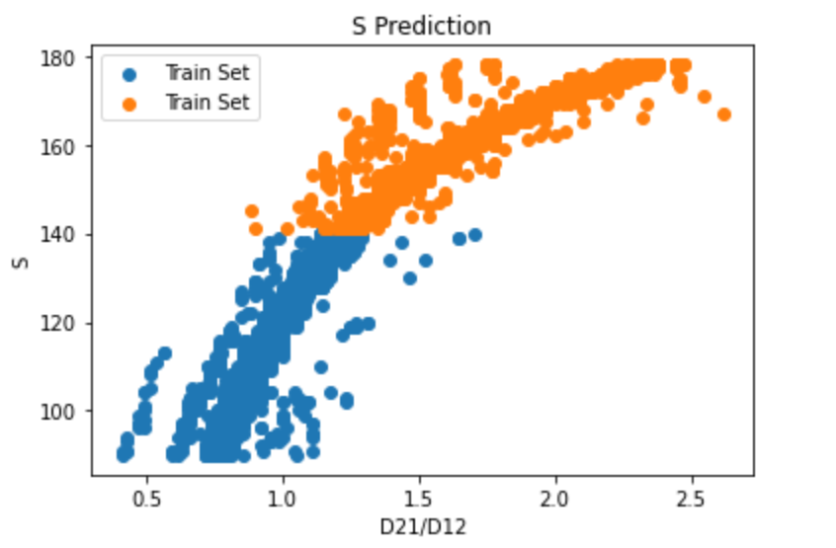
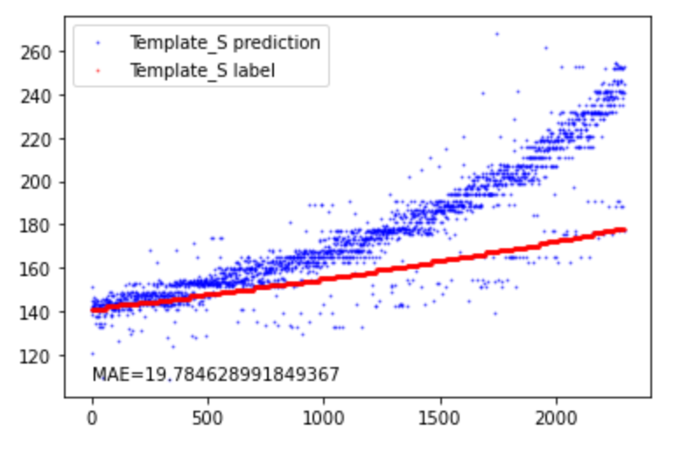
Work_2: S & D prediction in the noise level of 0.1 by getting template
Train Set
Test Set
Slope of Test Set
Slope of Train Set
A peculiar phenomenon observed in the S prediction
In the training set, correlation between D21/D12 and S reaches 0.95.
In the test set, correlation between D21/D12 and S also exceeds 0.9.
The feature extraction seems to be working perfectly.
However, their respective linear regression slopes differ significantly, leading to Template_S predictions often being higher.
The exact cause of this peculiarity hasn't been determined yet.
Notes:
Let's take a look at the results of using templates for S and D predictions.
There's a very peculiar phenomenon observed in the S prediction.
The peculiarity lies in the fact that:
In the training set, the correlation between D21/D12 and S reaches 0.95.
In the test set, the correlation between D21/D12 and S also exceeds 0.9.
The feature extraction seems to be working perfectly.
However, their respective linear regression slopes differ significantly, leading to Template_S predictions often being higher.
The exact cause of this peculiarity hasn't been determined yet.

Slide 15
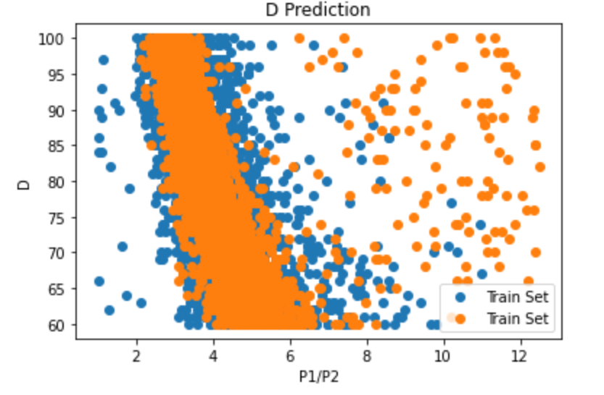
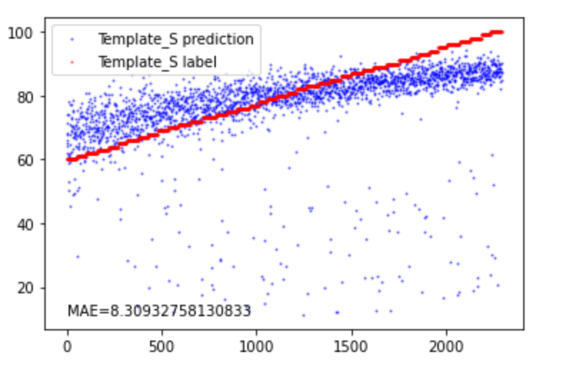
Work_2: S & D prediction in the noise level of 0.1 by getting template
Template_D prediction
Template_D label
Train Set
Test Set
outliers
Regarding D prediction, using templates for feature extraction seems to result in high number of outliers.
I suspect that this might be due to the influence of K-shapes on heights of small peaks.
I'm planning to work on eliminating this influence next week.

Slide 16
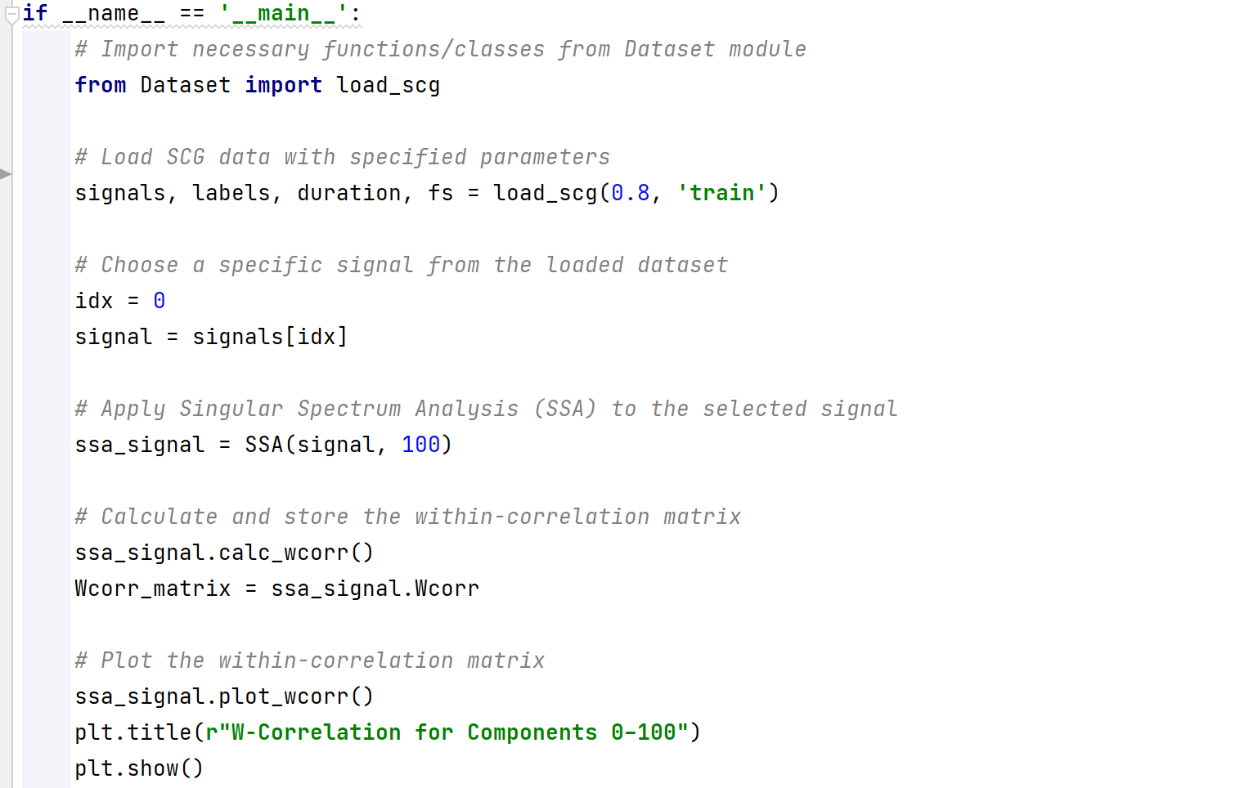
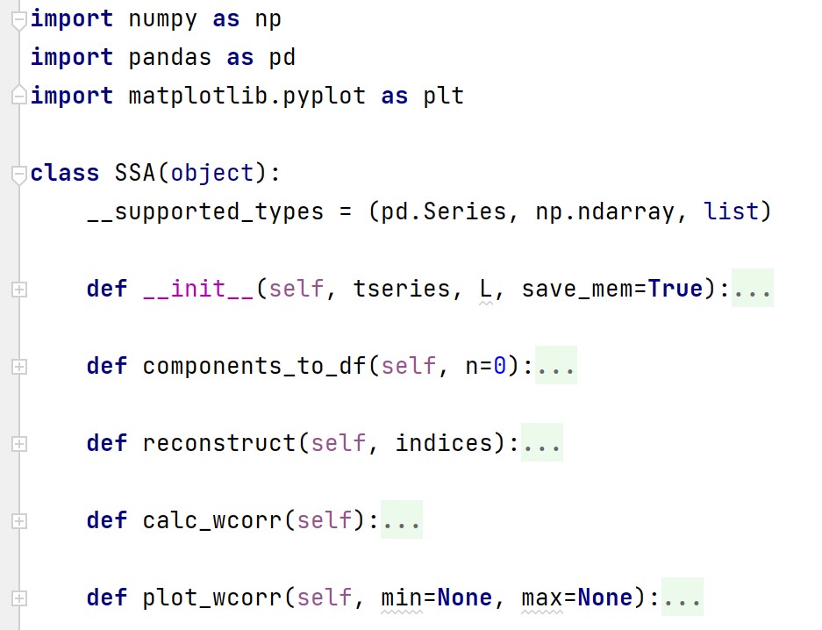
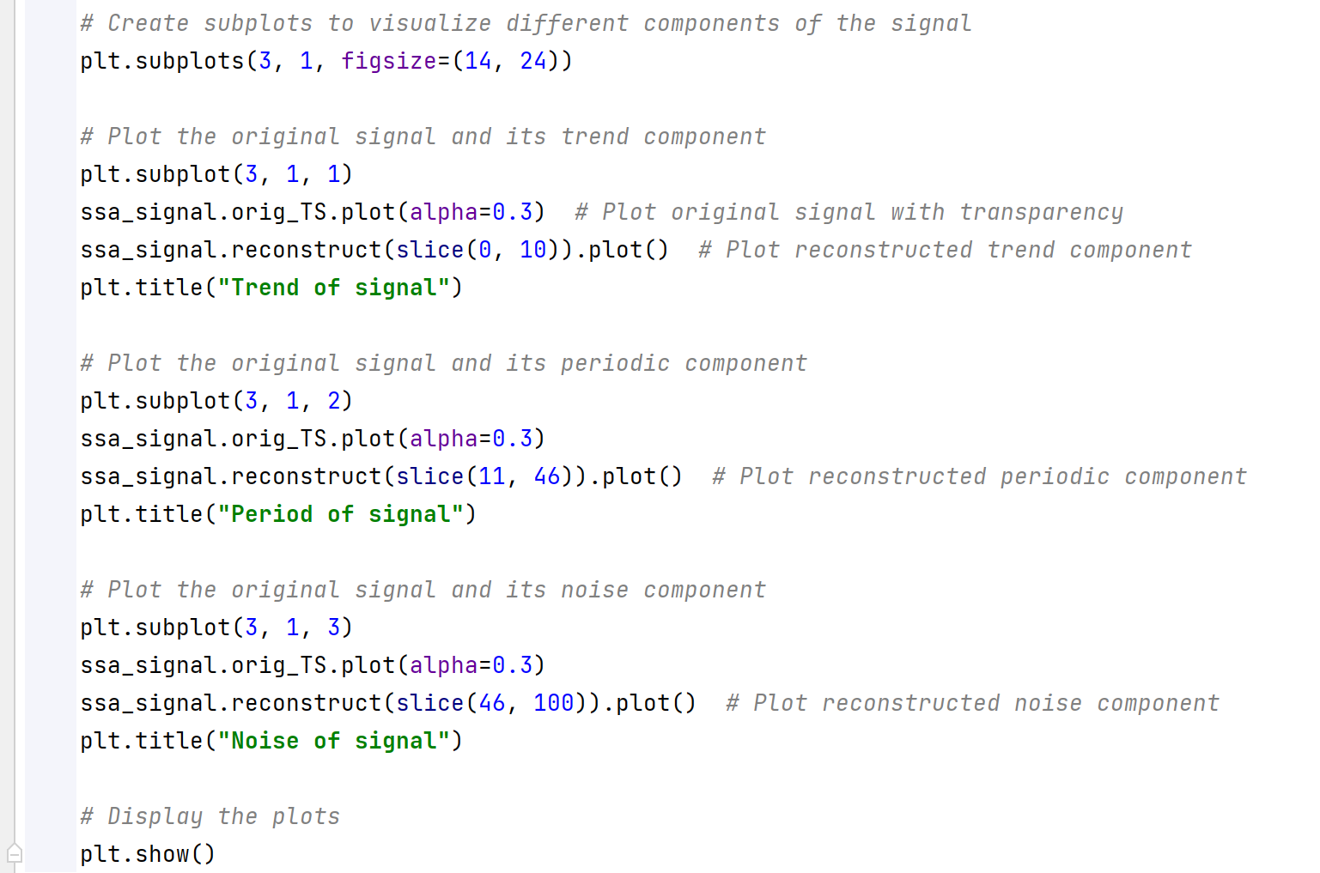
Work_3: Tutorial
Do these four Parts meet your requirement for this tutorial?
Part2. Example of Algorithm used in SCG
Part1. Implementation
Part4.
Code
Comments
Part3. Outputs of Example
Notes:
The work 3 is about tutorial
I need to confirm with you.
Currently, the tutorial has 4parts
Part1 is algorithm Implementation,
Part2 is Example of Algorithm used in SCG
Part3 is Outputs of Example
Part4 is code comments
these four aspects meet your requirements for this tutorial? If they don't meet the requirements, what should I add?

Slide 17
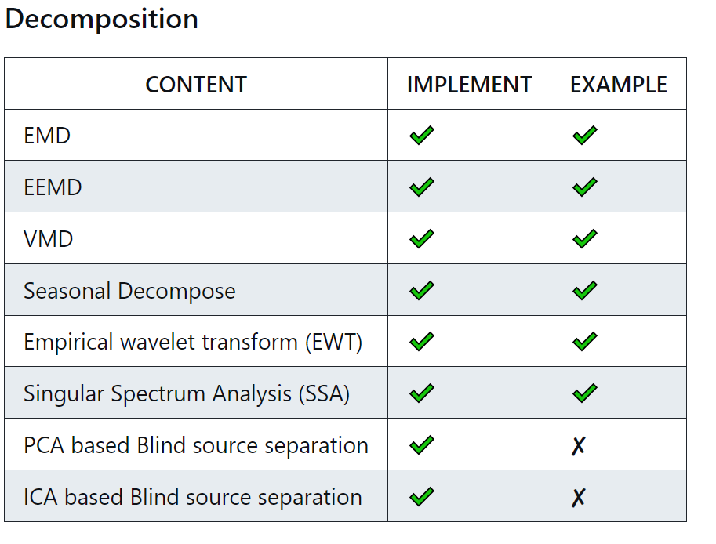
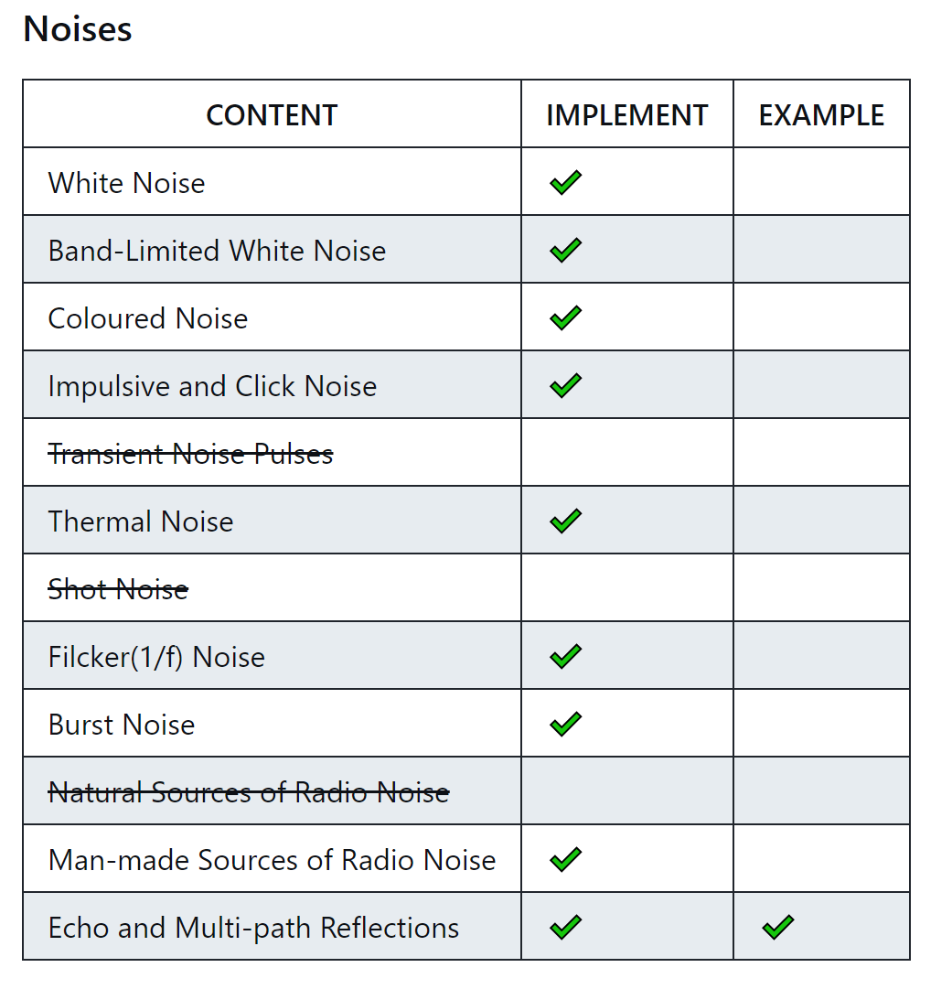
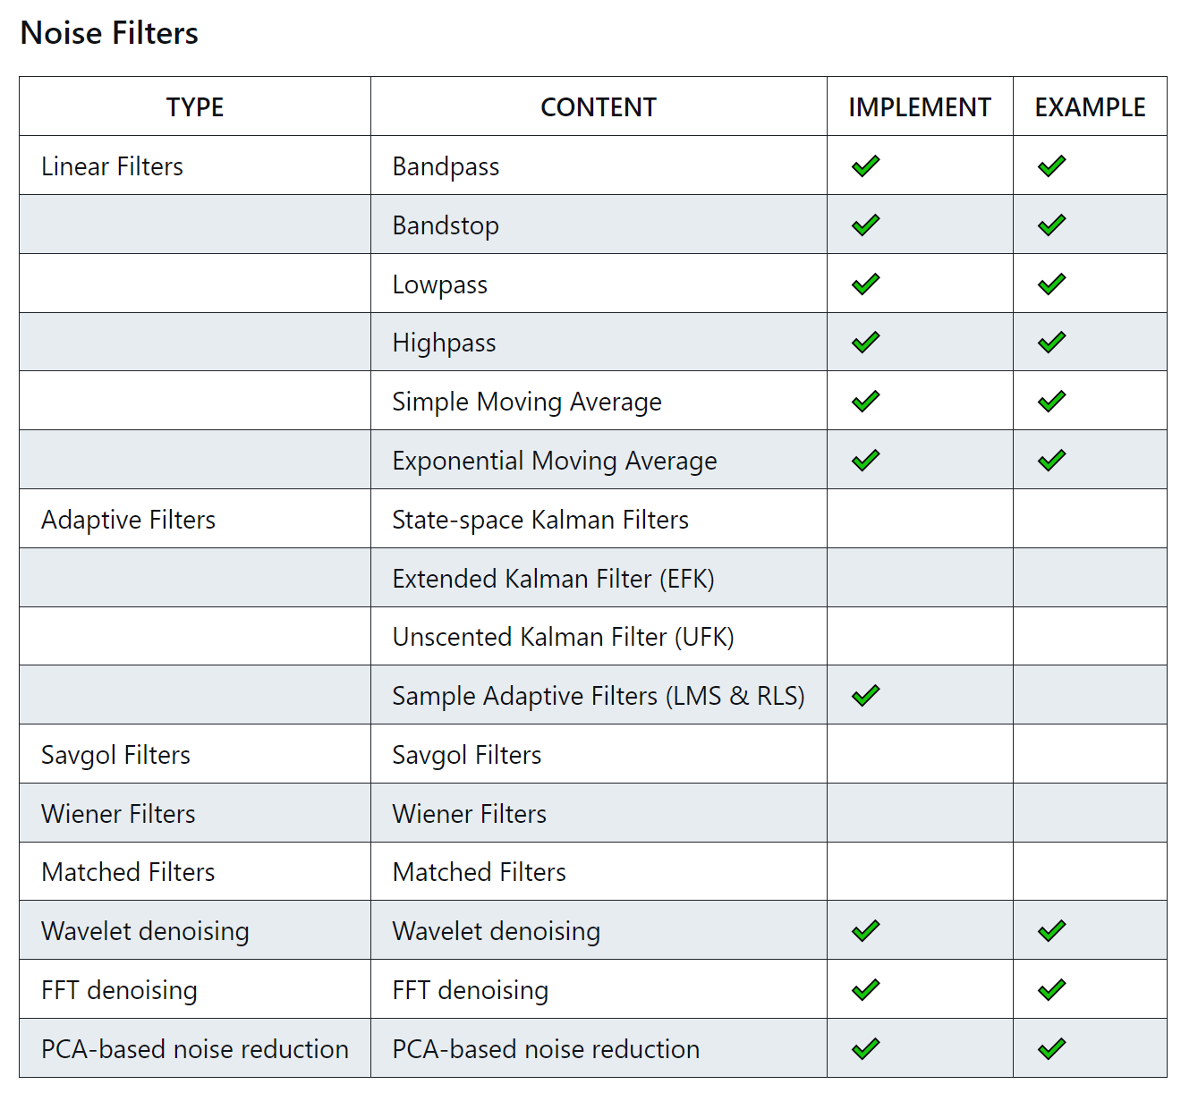
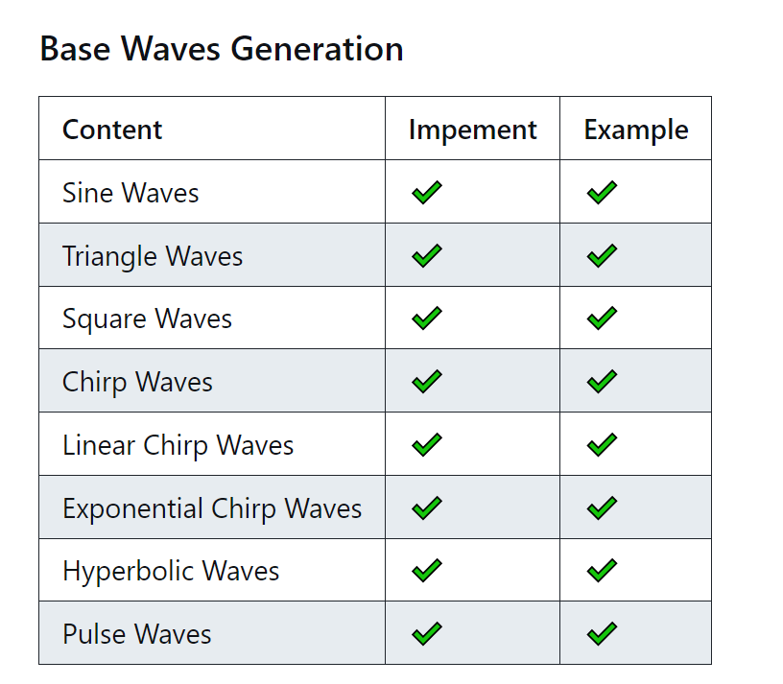
Work_3: Tutorial
Some advanced filters are not fully comprehensible at the moment. I will need to learn DSP and gradually work on implementing them.
Current SCG dataset doesn't provide a good example for algorithms, such as Blind Source Separation.
Notes:
关于Tutorial的书写，已近进入到了一个阶段了。
一些基础的内容，已经基本结束了
这一部分中最难的是advanced filter。Some advanced filters are not fully comprehensible at the moment. I will need to learn DSP and gradually work on implementing them.
目前也遇到一个问题：Current SCG dataset doesn't provide a good example for algorithms, such as Blind Source Separation.

Slide 18
Work_4: Theoretical knowledge Learning
Signals and Systems
Probability for Computer Scientists
Course: EE120, Berkeley
This week’s Progress:
Review 10 Lectures
Finish 1 lab
Next week’s plan:
Lecture 10 (the DFT; FIR filters)
Lecture 11 (Fourier transforms in two dimensions)
Finish 1 lab
Course: CS109, Standford
This week's progress:
Part * 12
Next week’s plan:
Part * 12
Notes:
This week, I have a hard time learning Hidden Markov Models.
I need to allocate some time to learning probability in order to better understand advanced concepts.

Slide 19
Questions
Do these four parts in my tutorial meet your requirement for this tutorial?
The SCG dataset is no longer suitable for many tutorial algorithms, for example, classifying signals. Should we build some simple datasets ourselves, or could you provide us with a simulated dataset?
What does this sentence mean in the document? It can be based on our SCG generator, and make it support different mother wavelets, such as Harr, Daubechies, Biorthogonal, Symlet, Meyer and Coiflets. I know the Nk2’s SCG simulation is based on Daubechies, should we use Harr or Symlet to simulate SCG?

Slide 20
Thanks!

